Slide 1
Computer Engineering
Generated for: Introduction to Operating Systems, Process Management Concepts, Memory Management Techniques
Notes:
Welcome to the Computer Engineering presentation covering multiple topics. Today we'll explore: Introduction to Operating Systems, Process Management Concepts, Memory Management Techniques.

Slide 2

Introduction to Operating Systems: Fundamentals and Overview
Manages computer hardware and software resources efficiently always
Acts as an intermediary between user and computer hardware components
Provides a platform for running applications and services smoothly
Controls input output and storage devices connected to system
Manages memory and storage allocation for optimal performance
Handles process scheduling and multitasking operations seamlessly
Ensures system security and authentication mechanisms are intact
Supports networking and communication protocols for data exchange
Provides a user interface for interacting with the system easily
Notes:
Welcome to the introduction of operating systems, a crucial component of computer engineering. In this section, we will explore the fundamental concepts and overview of operating systems. We will discuss how operating systems manage hardware and software resources, provide a platform for running applications, and ensure system security and authentication.

Slide 3
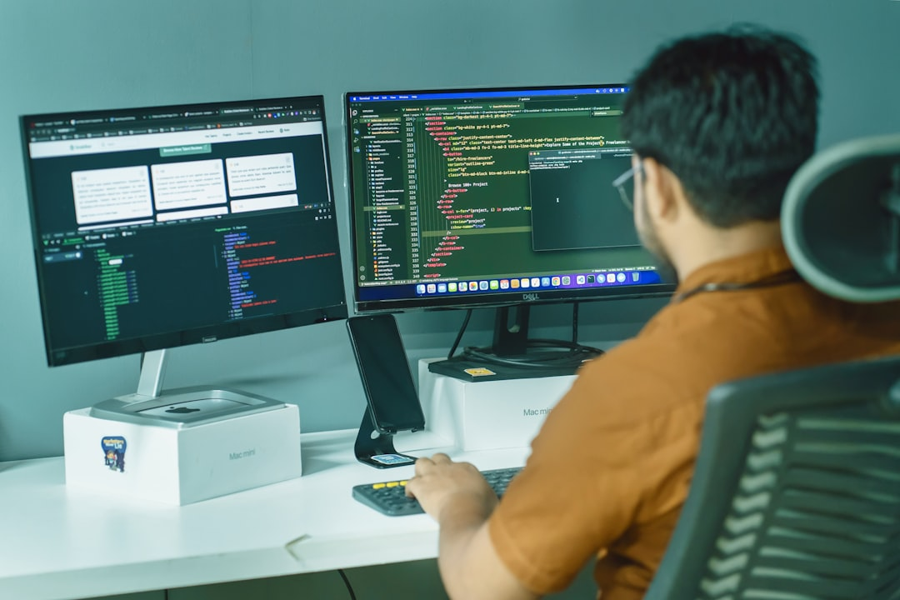
Introduction to Operating Systems: Fundamentals and Concepts
Defines interface between user and computer hardware
Manages computer hardware and software resources efficiently
Provides platform for running applications and services
Controls input/output operations and data storage
Ensures security and authentication of user accounts
Supports multitasking and multithreading capabilities
Manages memory allocation and deallocation processes
Optimizes system performance and responsiveness
Handles interrupts and exceptions gracefully
Provides utility programs for system maintenance
Notes:
In this section, we will explore the basics of operating systems, including their primary functions and key characteristics. Operating systems act as a bridge between users and computer hardware, managing resources and providing a platform for applications. We will also discuss the importance of operating systems in modern computing and their role in ensuring system security and performance.

Slide 4
Introduction to Operating Systems: Fundamentals and Concepts
Manages computer hardware and software resources efficiently always
Provides platform for running applications and services smoothly
Controls input output and storage devices effectively always
Manages memory and CPU allocation for optimal performance
Handles file system and data storage securely always
Supports networking and communication protocols seamlessly
Ensures security and authentication for users and data
Provides utility programs for maintenance and troubleshooting
Optimizes system performance and responsiveness always
Notes:
In this section, we will introduce the basics of operating systems, including their functions, importance, and key concepts. We will explore how operating systems manage computer hardware and software resources, provide a platform for running applications, and ensure security and authentication. This foundation will be crucial for understanding the more advanced topics in computer engineering.

